Slide 1
Testing Wavelet Denoising

Slide 2
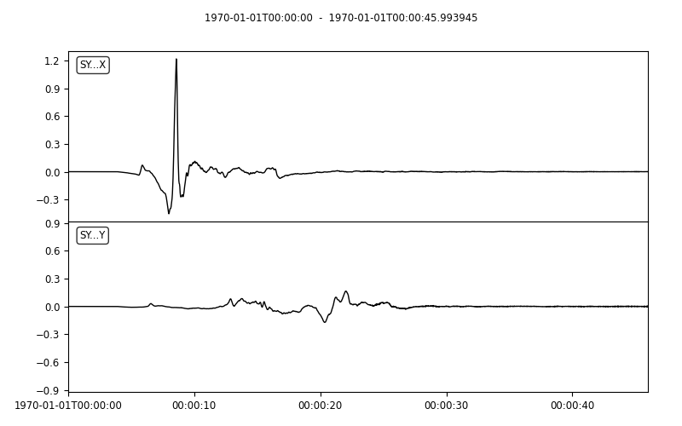
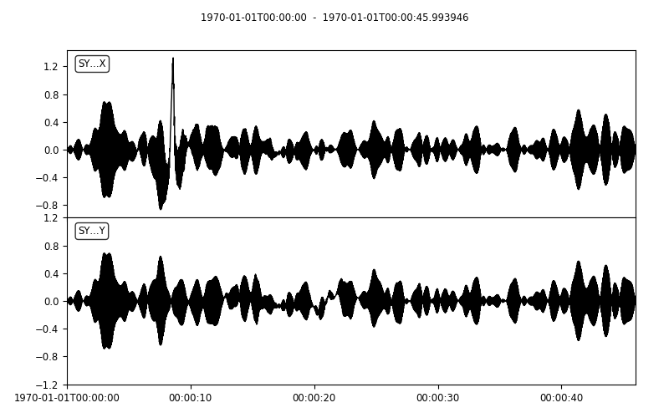
Wavelet Denoising Examples Original and noisy (working out the noise issues …)

Slide 3
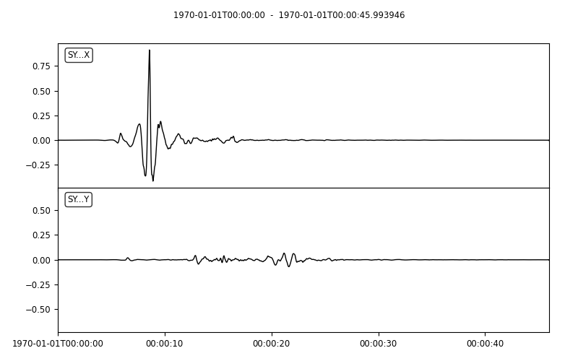
Reconstructed signal (using soft threshold and Coiflet wavelet)

Slide 4
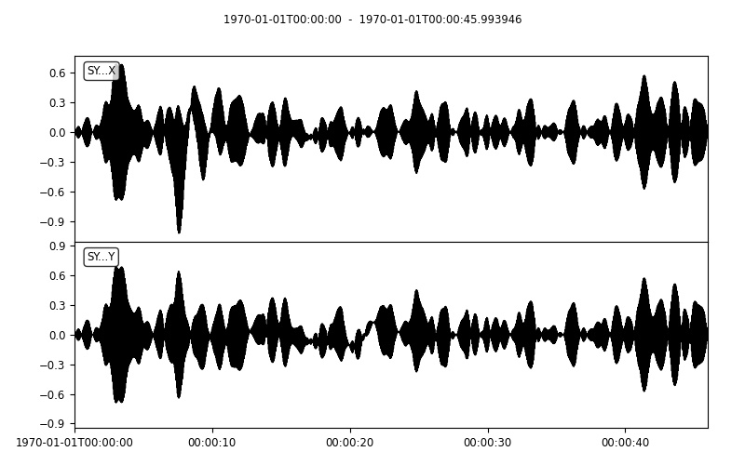
Noisy signal and reconstructed noise (using soft threshold and Coiflet wavelet)

Slide 5
Original (left) and reconstructed signal (right)

Slide 6
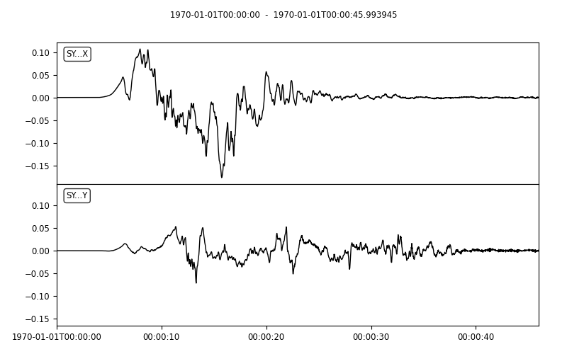
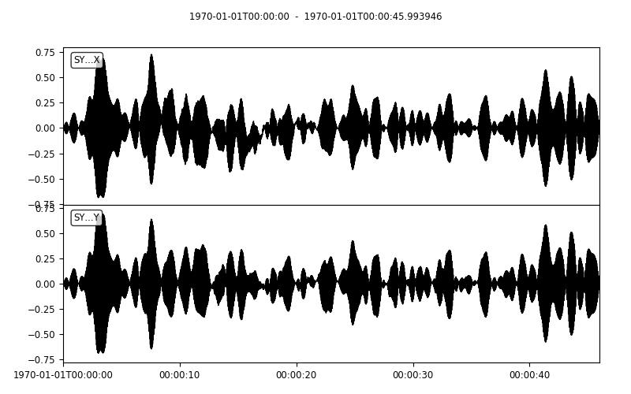
The other synthetic series, original and noisy
Mostly washed out by noise

Slide 7
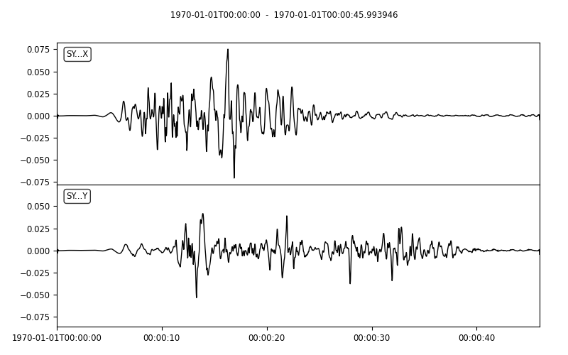
Reconstructed signal using soft threshold and Coiflet wavelet

Slide 8

Original noisy signal (left) and reconstructed noise (right)

Slide 9
Original signal (left) and reconstructed signal (right)

Slide 10
Sanity Checks/ Function Outputs

Slide 11
Generating Noise
Approach:
Need phase information to create a time series from NHNM/NLNM
Get spectral amplitude A = sqrt(2 * PSD)
Apply phase information via Z[i] = A[i] * np.exp(img * phase[i])

Slide 12
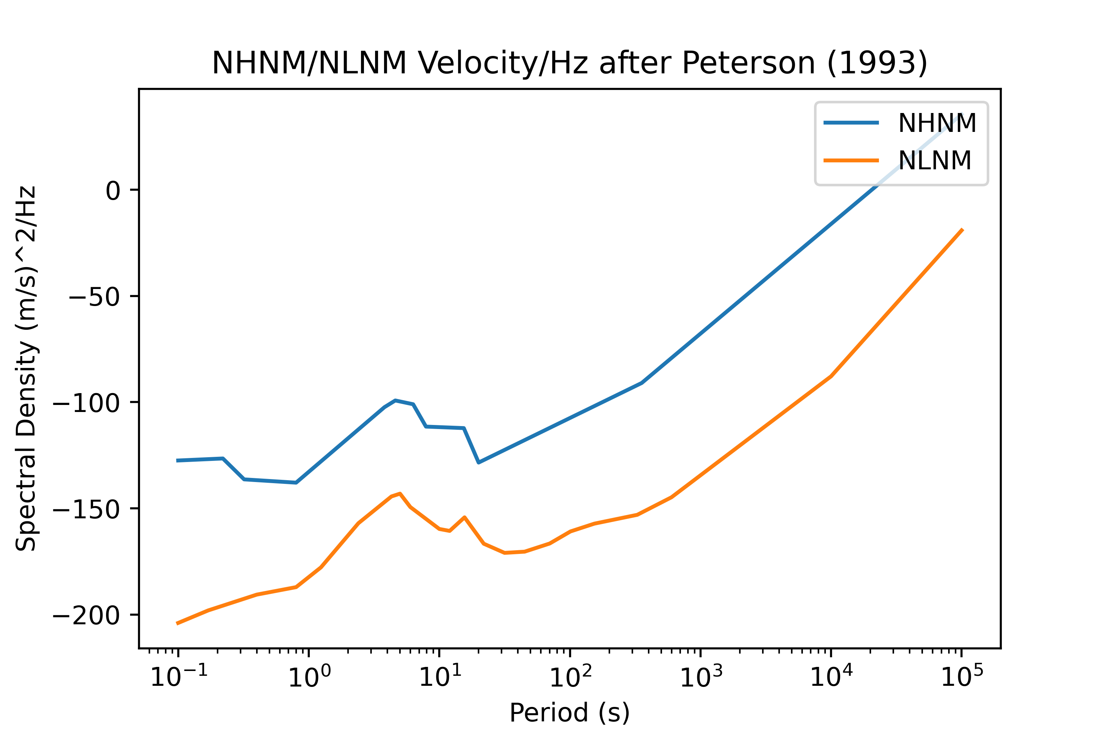
Starting Models

Slide 13
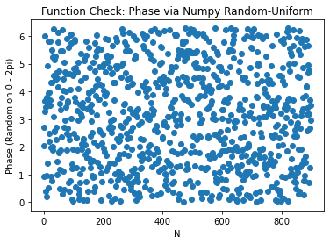
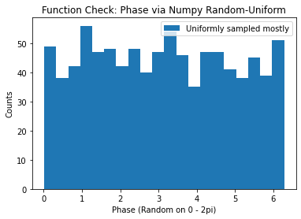
For each point, get random phase

Slide 14
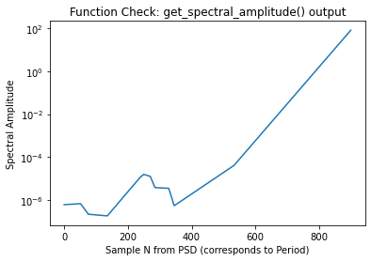
Check spectral amplitude – (after converting from dB and using sqrt())

Slide 15
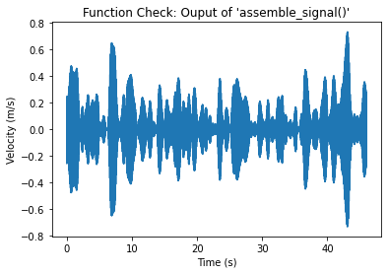
Take iFFT of signal in freq. domain with phase added

